Slide 1
Amazon Product Availability Checker using python
Presentation by Team Prasad

Slide 2

Abstract
This presentation introduces an Amazon product availability checker implemented in python. The tool allows users to monitor the availability of specific products on Amazon and receive notification when they become available. The project utilizes web scraping techniques to extract real-time data from the Amazon website.

Slide 3

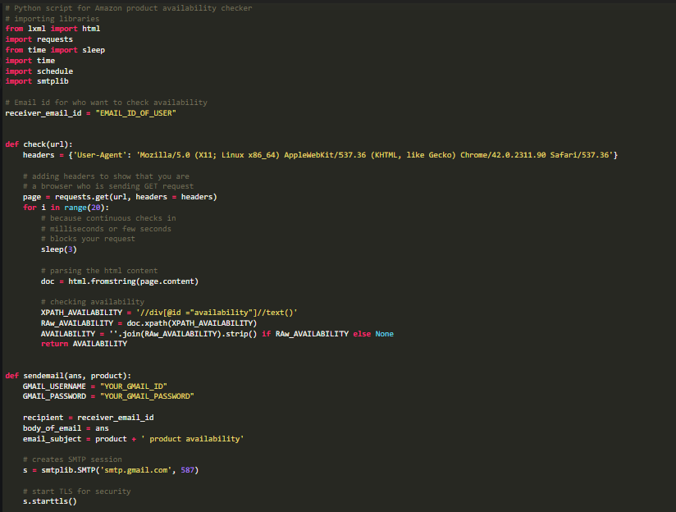
Code

Slide 4
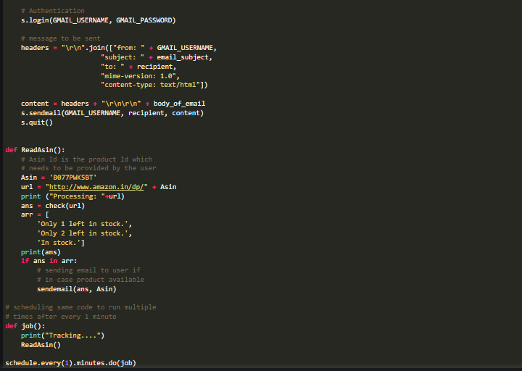
Code

Slide 5
Modules used
requests
time
schedule
smptlib

Slide 6
Modules Explanation
Requests
The requests module in Python simplifies the process of making
HTTP requests. It offers a user-friendly API for sending HTTP/1.1
requests and handling responses. Key features include support
for various HTTP methods (GET, POST, etc.). Passing parameters.
setting headers, and handling JSON data. The module is commonly
used for web scraping, API interactions, and general HTTP
communication due to its simplicity and versatility.
time
The time module in Python provides function for working with time-related tasks. It includes functionalities such as measuring time intervals, introducing delays, and formatting time. Key features include the time() function for obtaining the current time in seconds, sleep() for introducing delays, and strftime()
for formatting tome as string. The module is commonly used in
Applications that require time scheduling, or pausing execution

Slide 7
Modules Explanation
schedule
The schedule module in Python is used for scheduling tasks at specified intervals. It allows you to set up recurring jobs, like running functions periodically. The key feature is the schedule object, which lets you define when and how often a task should be executed. This module simplifies the process of scheduling repetitive tasks in a Python script or application.
Smtplib
The smtplib module in Python provides a simple client-side interface
for sending email using the Simple Main Transfer Protocol(SMPT). It
Allows you to connect to an SMTP server, send emails with attachments,
and handle various email-related tasks. This module is often used for
Automation email notifications and communication within Python scripts or applications

Slide 8
Conclusion
This Amazon product availability checker provides a simple and effective way to stay informed about the availability of desired products, allowing users to make timely purchases. The combination of web scraping and email notification enhances the user experience by automating the monitoring process

